Slide 1


CMR TECHNICAL CAMPUS UGC (Autonomous) Kandlakoya, Medchal Road, Hyd-501401 Department of Computer Science and Engineering
A
Major Project On
E-Pilots: A System to Predict Hard Landing During the Approach Phase of Commercial Flights
BATCH NO: 11
GROUP MEMBERS :
207R1A0569 B. Vedika
207R1A0561 A. Harshitha Naidu
207R1A0565 B. Ashok
UNDER THE GUIDENCE OF:
Dr . J. Narasimharao
(Associate Professor)

Slide 2

TABLE OF CONTENTS
Abstract
Existing System
Disadvantages of Existing System
Proposed System
Advantages of Proposed System
System Requirements
Novelty
System Architecture
Modules
UML Diagrams
Sample Code
Results
Conclusion
Future Scope
References

Slide 3
ABSTRACT
This project aims to develop a system called E-Pilots that uses machine learning algorithms to predict hard landings during
the approach phase of commercial flights.
The system will analyze flight data to precede hard landings.
The goal is to provide pilots with real-time warnings and guidance to prevent accidents and improve safety.
The research methodology includes the collection and analysis of flight data, the development and testing of machine
learning algorithms, and the integration of the E-Pilots system with existing flight systems.
The findings of this project are expected to contribute to the improvement of aviation safety and reduce the occurrence of hard landings. The implications of this research may also extend to other areas of aviation safety and flight automation.

Slide 4
EXISTING SYSTEM
One existing system for hard landing prediction during the approach phase of commercial flights is the SmartLand system developed by Honeywell Aerospace.
The SmartLand system uses multiple sensors on the aircraft to provide pilots with real-time information about the aircraft's position, velocity, and trajectory during the approach phase.
The system then uses algorithms to analyze this data and detect any signs of a hard landing, such as excessive descent rate, high vertical acceleration, or touchdown beyond the designated touchdown zone.

Slide 5
DISADVANTAGES OF EXISTING SYSTEM
No security
Less efficiency
Limited data analysis
Insufficient Integration
High Maintenance Costs

Slide 6

PROPOSED SYSTEM
The system would use machine learning algorithms, such as Naive Bayes, Logistic Regression, SVM, Decision Tree,
SGD Classifier to analyze the flight data and identify patterns that precede hard landings. These patterns might include changes in altitude, airspeed, or rate of descent. Once the system detects these patterns, it would provide real-time warnings and guidance to pilots to prevent hard landings

Slide 7
ADVANTAGES OF PROPOSED SYSTEM
Enhanced safety,
Accurate Predictions
Cost Savings
Continuous Improvement
Automated Information

Slide 8
SYSTEM REQUIREMENT
HARDWARE REQUIREMENTS
SOFTWARE REQUIREMENTS
Processor
RAM
Hard Disk
KeyBoard
Mouse
Monitor
: Pentium –IV
: 4 GB (min)
Operating system
: Windows 7 Ultimate.
Coding Language
: Python.
: 20 GB
Front-End
: Python.
: Standard Windows Keyboard
: Two or Three Button Mouse
Back-End
: Django-ORM
: SVGA
Designing
: Html, css, javascript.
Data Base
: MySQL (WAMP Server).

Slide 9
NOVELTY The project proposes a novel hybrid model that integrates features capturing temporal dependencies of various aircraft variables. This hybrid model is designed to enhance predictive capabilities for identifying hard landing events. The system is designed to be cockpit-deployable, providing real-time support to flight crews during decision-making processes. This aspect is crucial for enhancing aviation safety as it enables flight crews to receive timely information and make informed decisions, such as executing a go-around maneuver when the risk of a hard landing is predicted. Overall, the novelty of the "E-pilot" project lies in its comprehensive approach to leveraging machine learning technology.

Slide 10
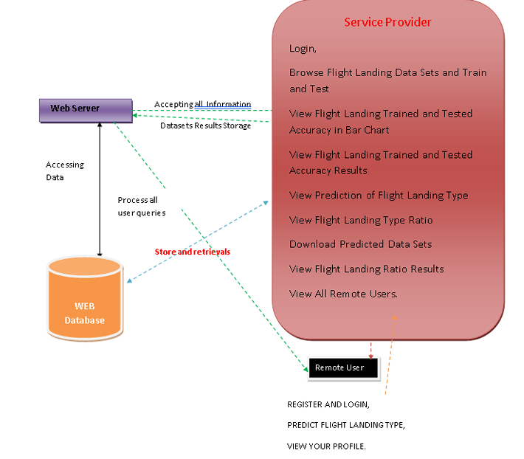
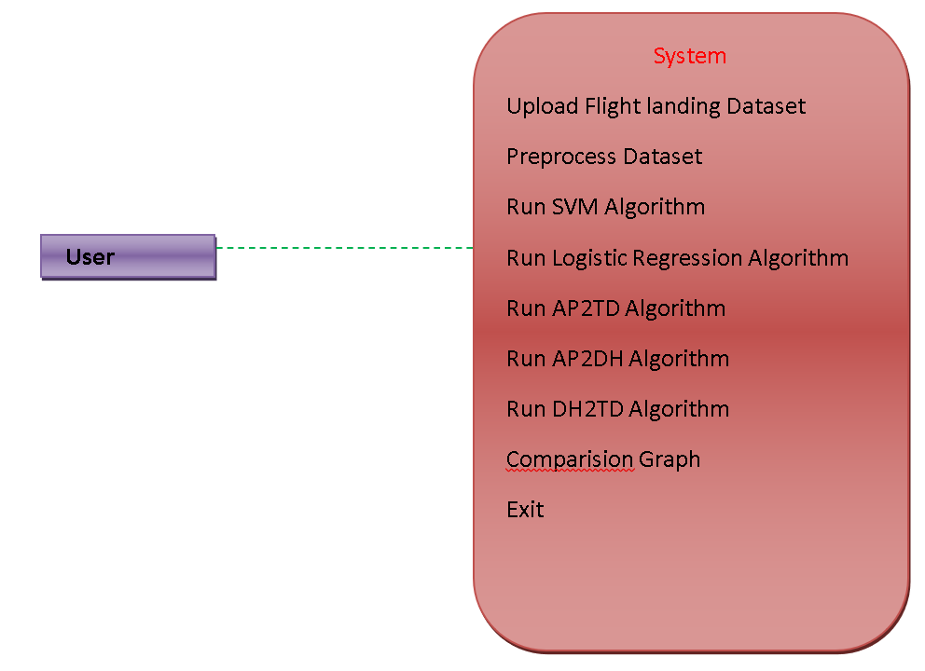
SYSTEM ARCHITECTURE

Slide 11
MODULES
Upload Dataset : This module involves the process of acquiring the necessary data for training and testing your machine learning model. The dataset likely contains information on various parameters or variables recorded during the approach phase of commercial flights, such as altitude, airspeed, pitch angle, etc. The dataset could be collected from flight data recorders.
Preprocessing Data :Preprocessing the collected data to clean, normalize, and transform it into a suitable format for training the machine learning models.
Comparision : This module involves the comparision of results after performing the execution with the various algorithms. The result may be in the form of Bar Graphs.

Slide 12
UML DIAGRAMS
Use Case Diagram
Class Diagram
Sequence Diagram
Activity Diagram

Slide 13
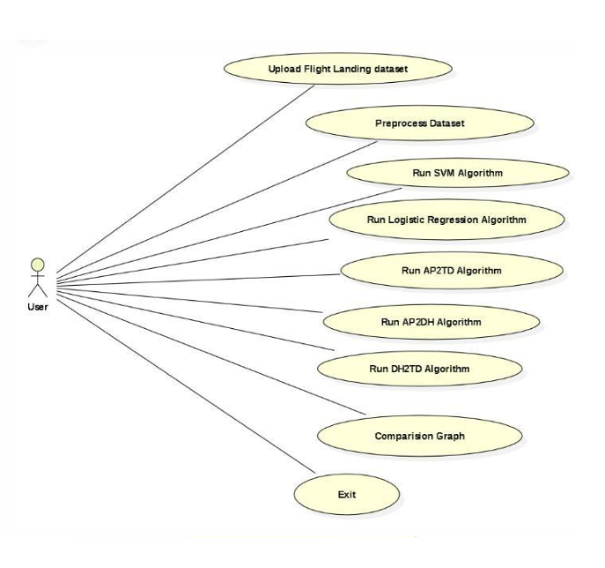
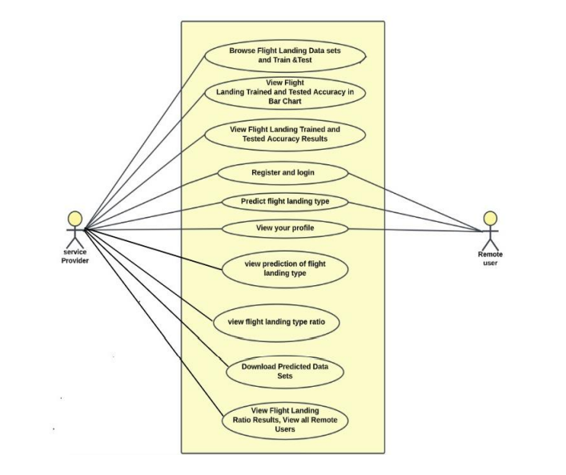
USECASE DIAGRAM

Slide 14
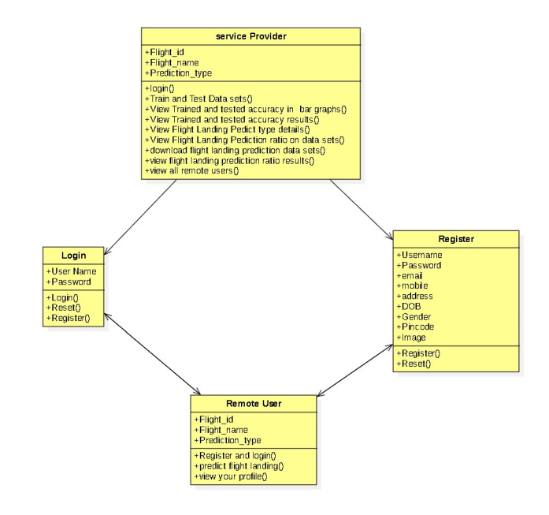
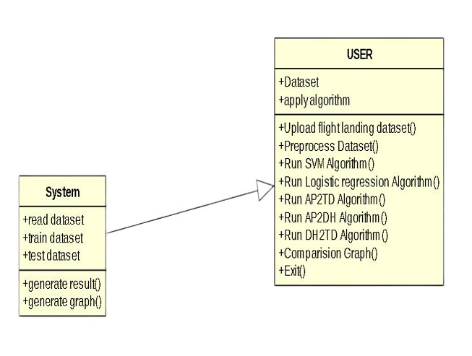
CLASS DIAGRAM

Slide 15
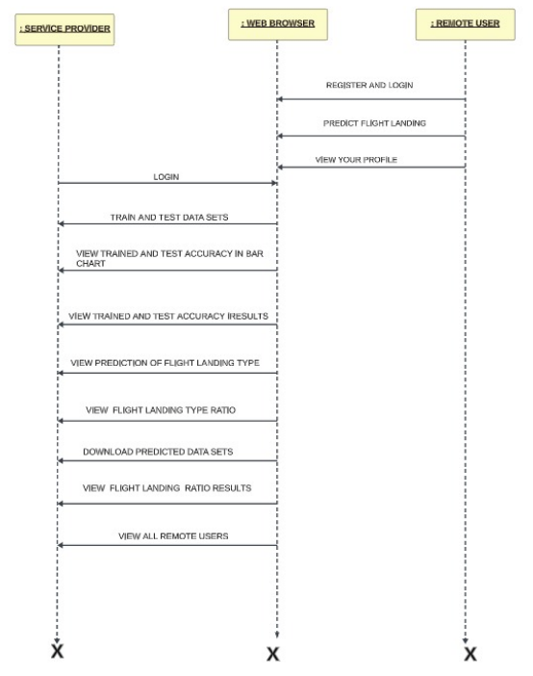
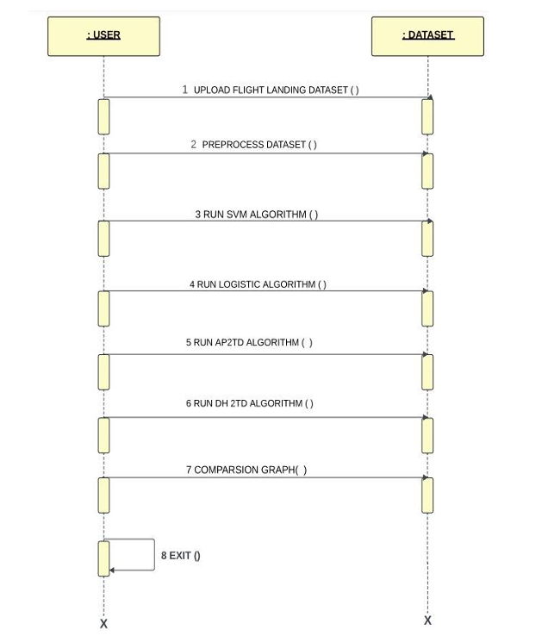
SEQUENCE DIAGRAM

Slide 16
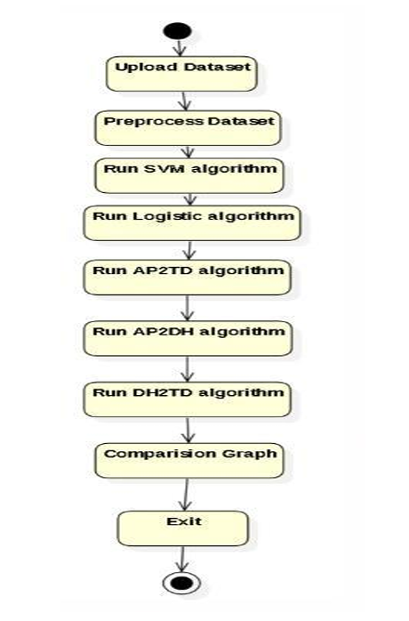
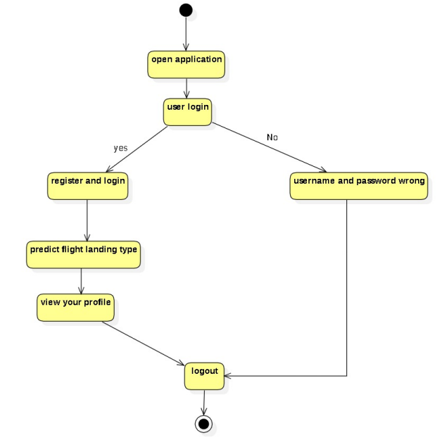
ACTIVITY DIAGRAM

Slide 17
SAMPLE CODE
from tkinter import messagebox
from tkinter import *
from tkinter import simpledialog
import tkinter
from tkinter import filedialog
import matplotlib.pyplot as plt
from tkinter.filedialog import askopenfilename
from sklearn.metrics import recall_score
from sklearn.model_selection import train_test_split
from sklearn.metrics import accuracy_score
from sklearn.linear_model import LogisticRegression
from sklearn import svm
import pandas as pd
import numpy as np
from sklearn.preprocessing import StandardScaler
from keras.models import Sequential
from keras.layers import Dense
from keras.layers import Dropout
from keras.layers import LSTM
from keras.utils.np_utils import to_categorical
from keras.models import model_from_json

Slide 18
global filename
global dataset
global Y, all_data
global pilot_X_train, pilot_X_test, pilot_y_train, pilot_y_test
global actuator_X_train, actuator_X_test, actuator_y_train, actuator_y_test
global physical_X_train, physical_X_test, physical_y_train, physical_y_test
global all_X_train, all_X_test, all_y_train, all_y_test
global sensitivity, specificity
global pilot, actuator, physical
def uploadDataset():
global pilot, actuator, physical, Y, all_data
text.delete('1.0', END)
filename = filedialog.askdirectory(initialdir = ".")
pilot = pd.read_csv("Dataset/Pilot.csv")
actuator = pd.read_csv("Dataset/Actuators.csv")
physical = pd.read_csv("Dataset/Physical.csv")
Y = physical['label'].values
pilot.drop(['label'], axis = 1,inplace=True) #read pilot, actuator and physical dataset
actuator.drop(['label'], axis = 1,inplace=True)
physical.drop(['label'], axis = 1,inplace=True)

Slide 19
all_data = [physical, actuator, pilot] #merge all datasets to train SVM and logistic regression
all_data = pd.concat(all_data, axis=1)
text.insert(END,"Pilot Dataset \n\n")
text.insert(END,str(pilot.head())+"\n\n")
text.insert(END,"Actuator Dataset \n\n")
text.insert(END,str(actuator.head())+"\n\n")
text.insert(END,"Physical Dataset \n\n")
text.insert(END,str(physical.head())+"\n\n")
text.update_idletasks()
labels, count = np.unique(Y, return_counts = True)
height = count
bars = ('Not Hard Landing','Hard Landing')
y_pos = np.arange(len(bars))
plt.bar(y_pos, height)
plt.xticks(y_pos, bars)
plt.xlabel("Landing Type")
plt.ylabel("Counts")
plt.title("Different Landing Graphs in Dataset")
plt.show()

Slide 20
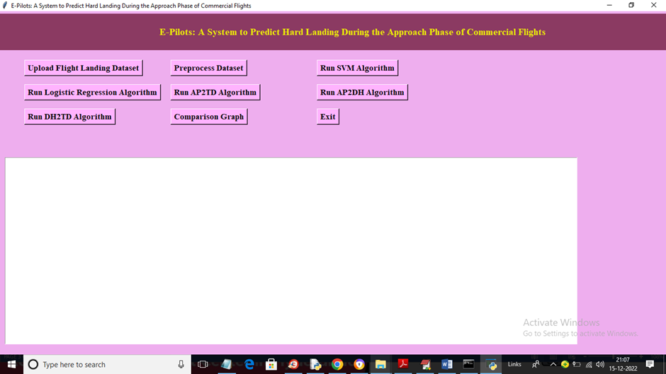
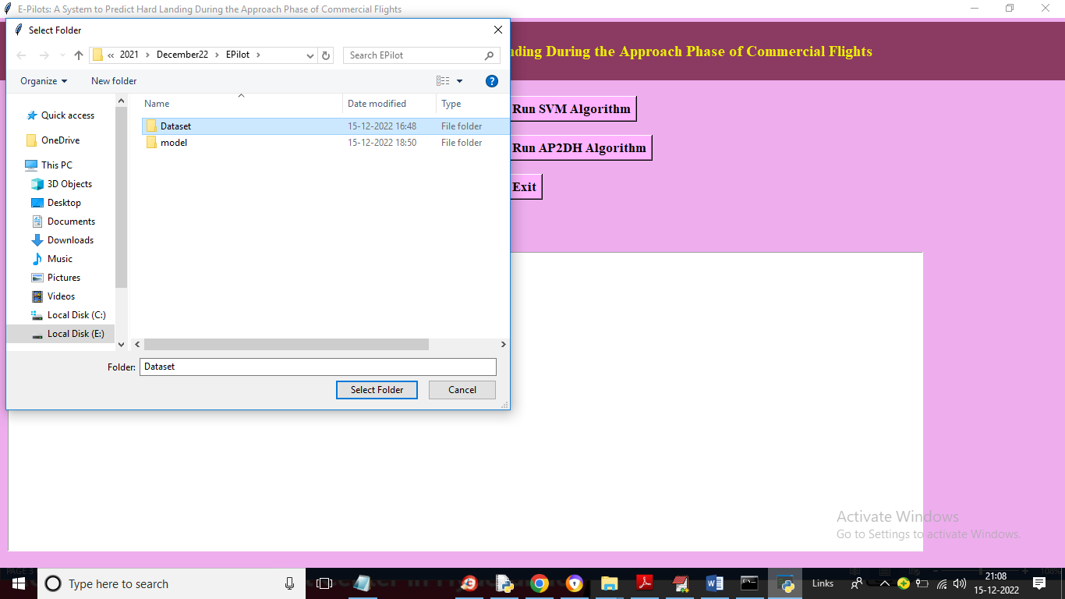
RESULTS

Slide 21
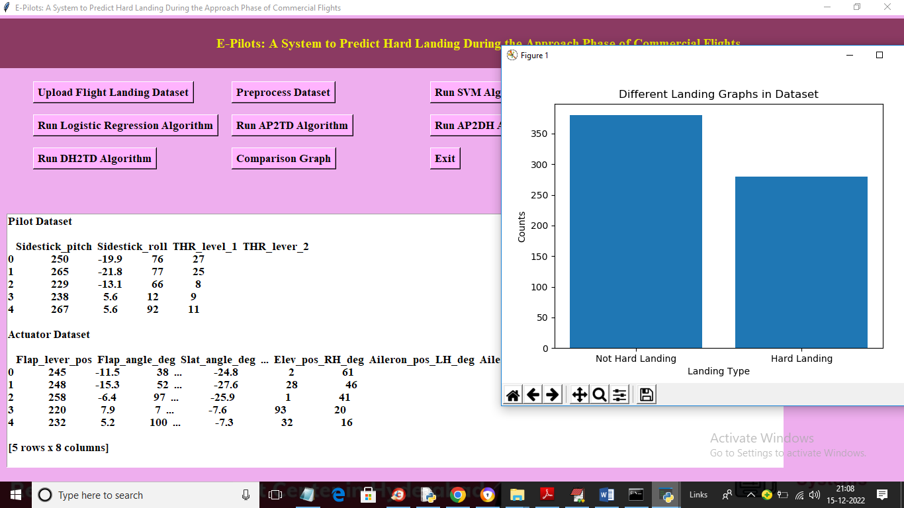
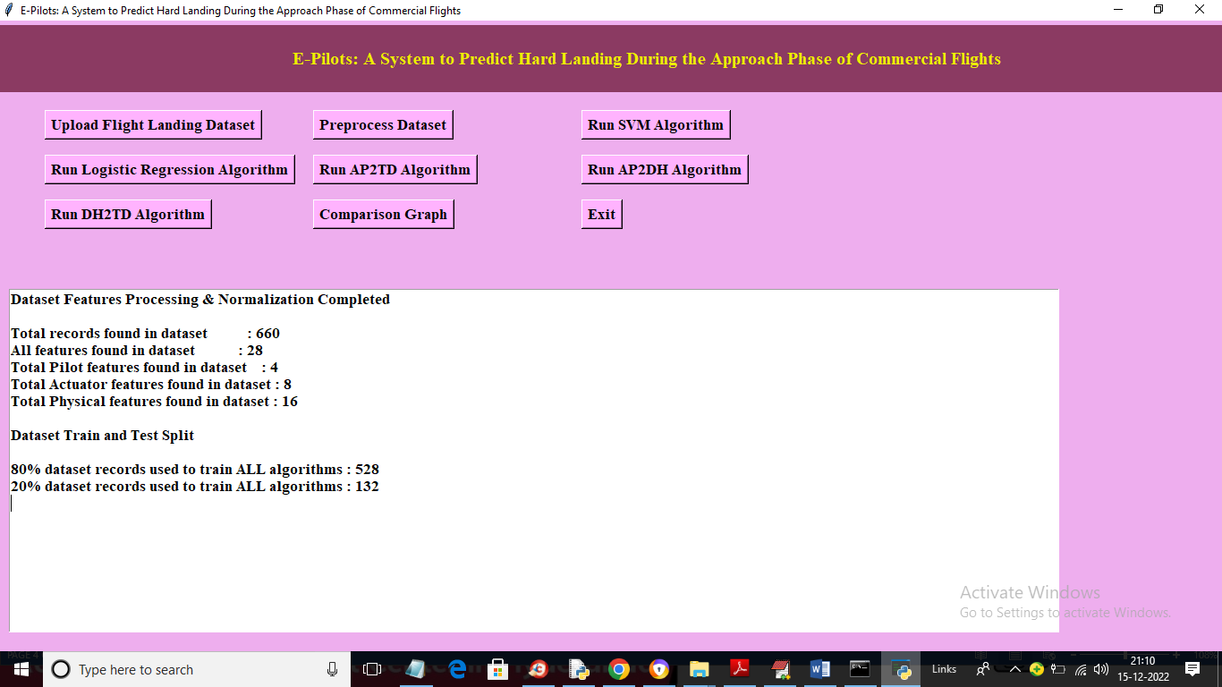

Slide 22
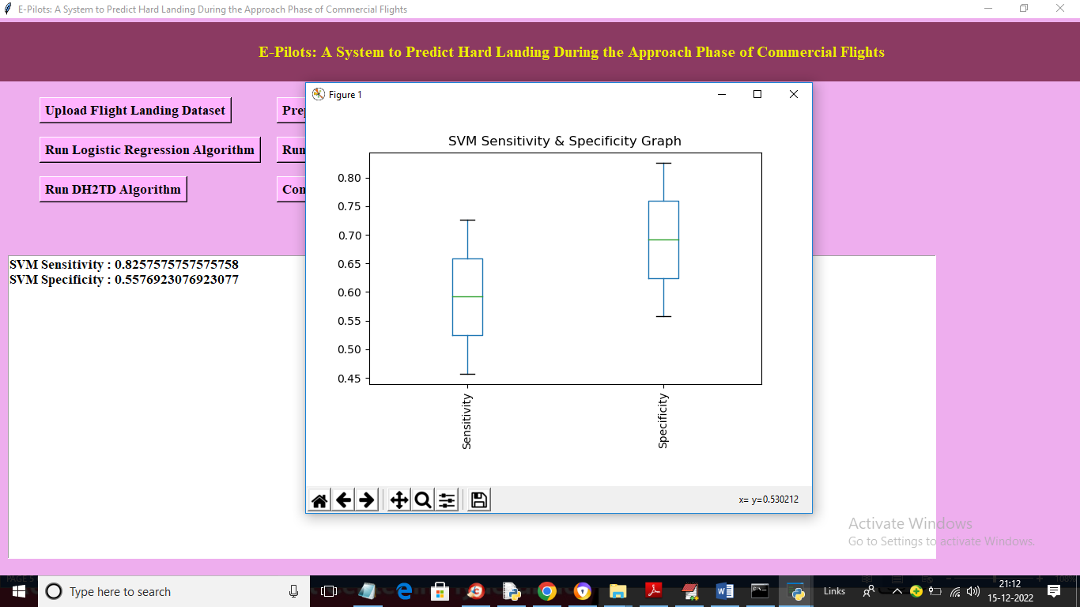
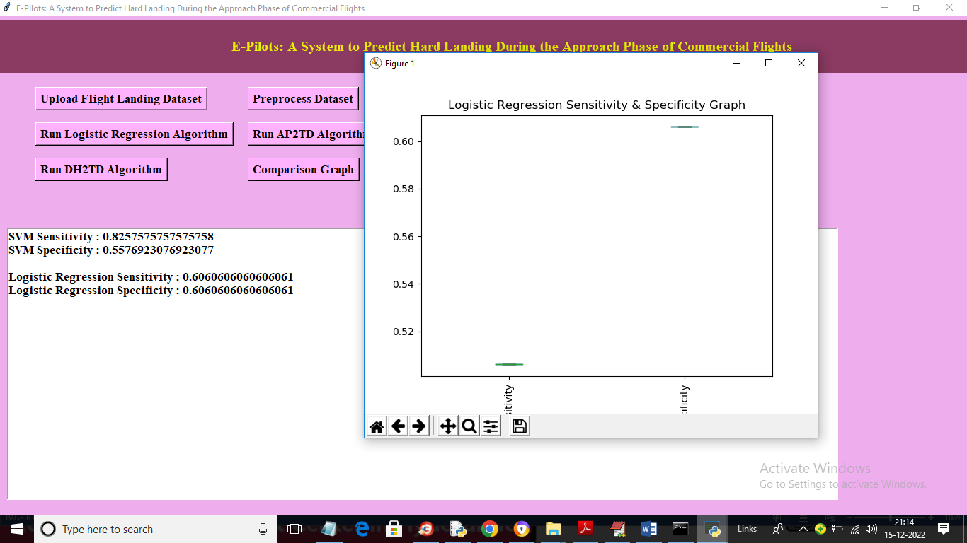

Slide 23
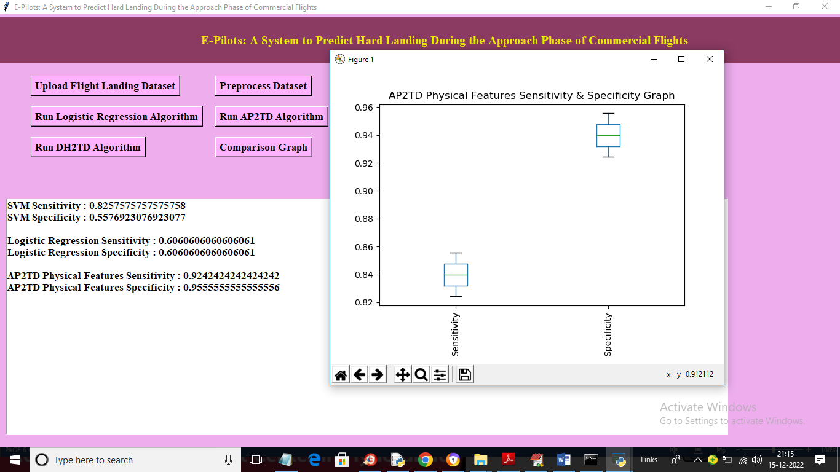
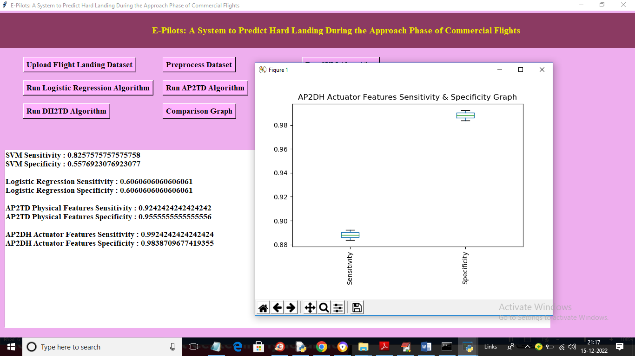

Slide 24
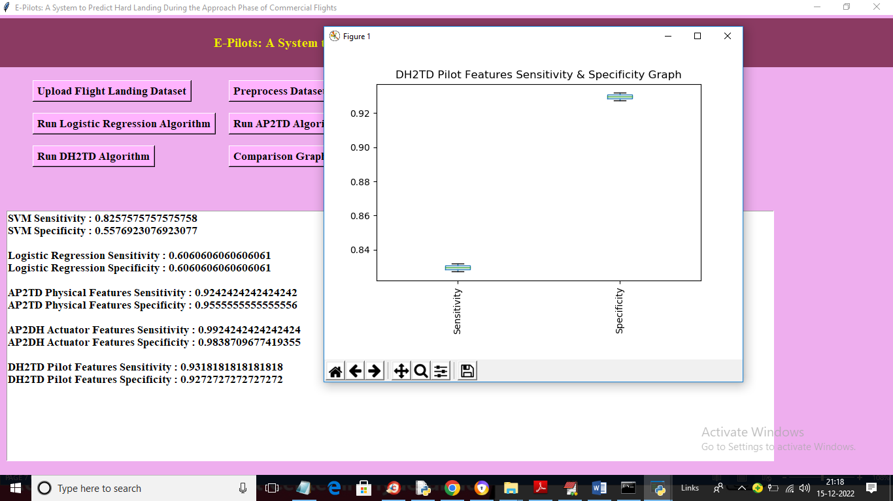
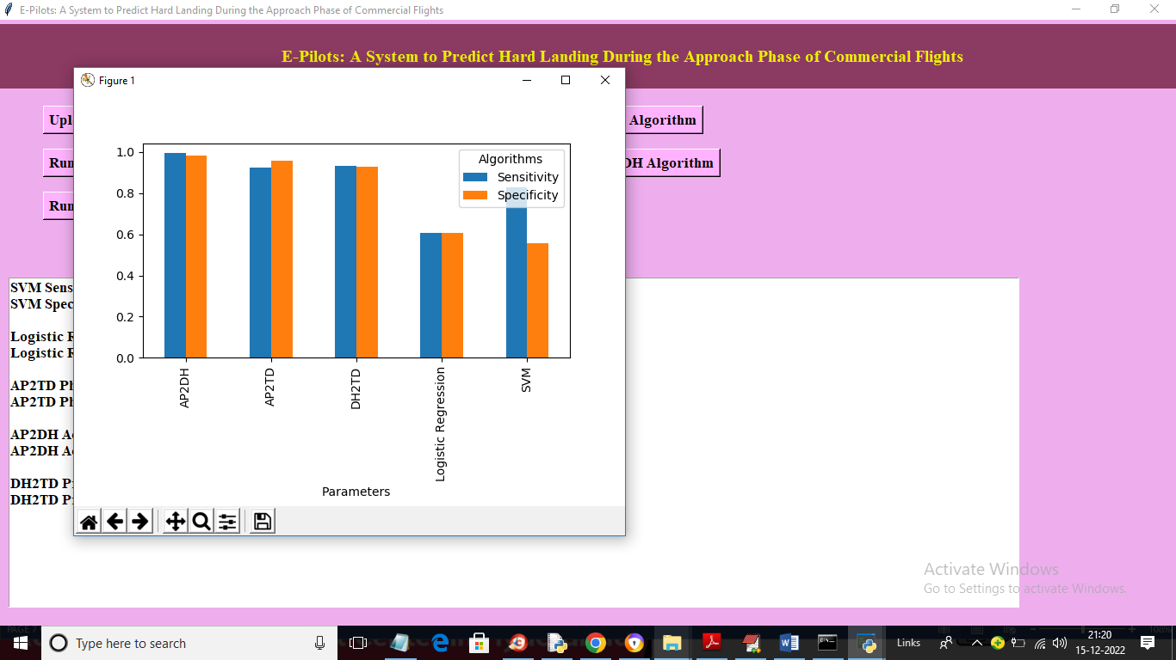

Slide 25
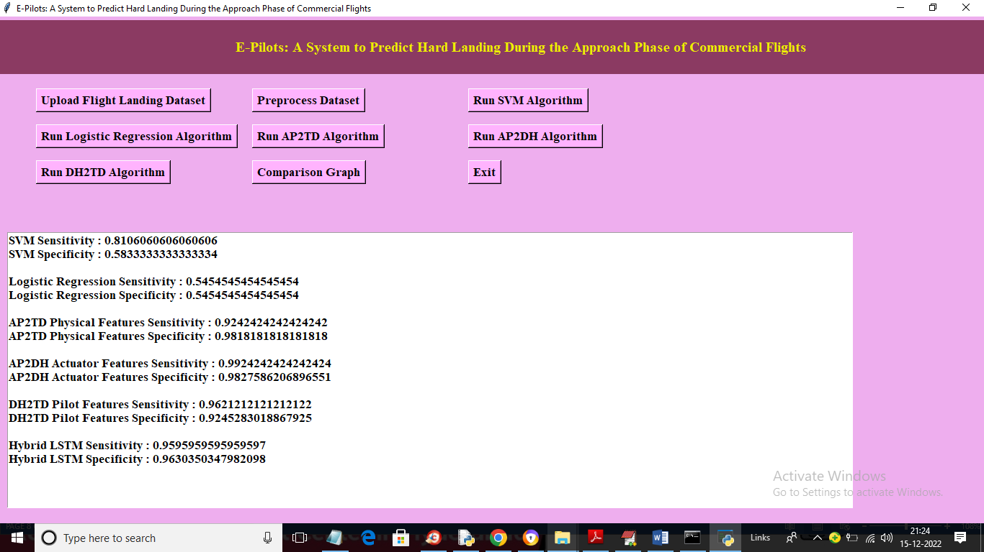

Slide 26

FUTURE SCOPE
The future scopes aim to enhance the system's capabilities, improve flight safety, and provide more comprehensive support to pilots, air traffic controllers, and other stakeholders involved in the landing phase of commercial flights.

Slide 27
REFERENCES
[1] Boeing Commercial Airplanes. Statistical summary of commercial jet airplane accidents–worldwide operations| 1959–2017. Aviation Saf., Seattle,WA, USA, 2018.
[2] European Aviation Safety Agency. Developing standardised fdm-based indicators. Technical report, European Aviation Safety Agency, 2016.
[3] Federal Aviation Administration. Advisory circular ac no: 91-79a mitigating the risks of a runway overrun upon landing. Technical report, Federal Aviation Administration, 2016.
[4] Michael Coker and Lead Safety Pilot. Why and when to perform a goaround maneuver. Boeing Edge, 2014:5– 11, 2014.
[5] Tzvetomir Blajev andWCurtis. Go-around decision making and execution project: Final report to flight safety foundation. Flight Safety Foundation, March, 2017.

Slide 28

CONCLUSION
The project "E-Pilots: A System to Predict Hard Landing During the Approach Phase of Commercial Flights" aims to enhance flight safety by predicting the likelihood of hard landings. The system utilizes machine learning algorithms, such as decision trees and SGD classifiers, to analyze historical flight data and generate predictions. By providing early warnings and proactive measures, the system can assist pilots and air traffic controllers in mitigating the risk of hard landings. The implementation of this project requires data collection, model training, system development, integration, and testing. The future scope includes refining the prediction models, integrating real-time data sources, facilitating collaborative decision-making, and expanding the system's capabilities. Overall, this project contributes to improving flight safety and reducing the occurrence of hard landings during commercial flights

Slide 29
GITHUB LINK
https://github.com/burrevedika/EPilot

Slide 30


THANK YOU!

